Slide 1
Beyond Buttons : Rethinking Control
Alex Wood
Experimental Interfaces for Novel Gameplay
An experience using custom made control systems designed for further immersion.

Slide 2

The Research
Experimental Games Production
GDC Conferences – Alt.CTRL.GDC
Itch.io – Experimental
Interactive Arcades / T.N.V.M
Arduino.cc / Freenove
Unreal Engine Documentation
SerialCom / RamirosLab

Slide 3

The End Goal
Interactive Arcades
Research Route / PhD

Slide 4

The ‘Original’ Idea
A few tech demos
Varying technology
Not focussed on the game

Slide 5

The New Idea
Single Game
More Developed
Narrative

Slide 6

The Game
Arduino Communication
Joystick
Narrative
You are an engineer for an experimental space exploration company, recently your team launched an interplanetary explorer, into space. During a simple space walk they were hit by a bit of space debris, and they lost the ability to control their jetpack.
In a panicked frenzy they call space control for help, but you are the only one with the kit to help; use your B.E.A.C.O.N (Briefcase for Emergency Assistance on Cosmic Operations and Navigation) to help guide the astronaut back to the shuttle before they run out of oxygen or fuel.

Slide 7

The Hardware
Circuit Board
Printer
Joystick
Briefcase

Slide 8
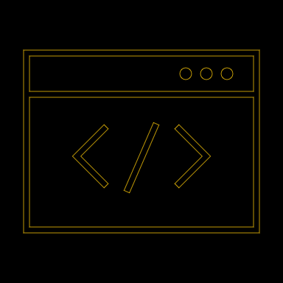
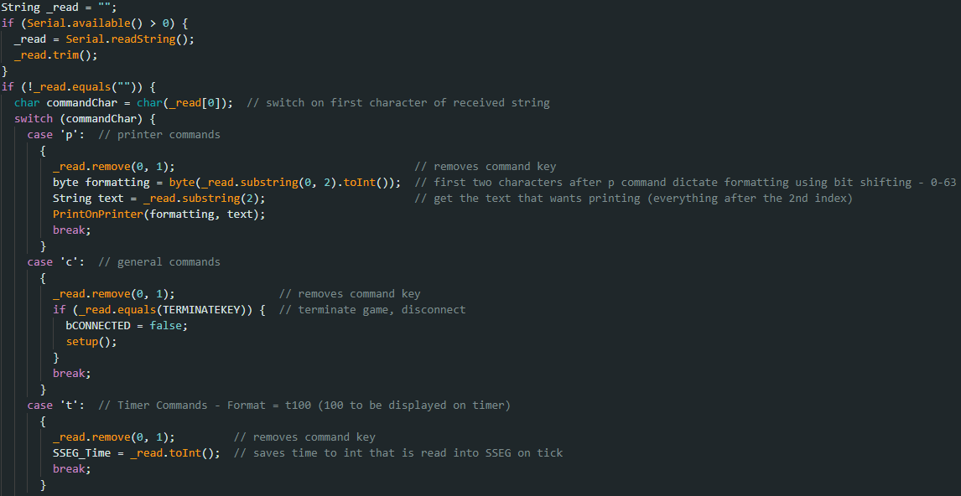
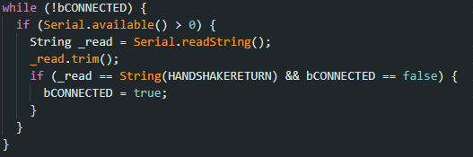
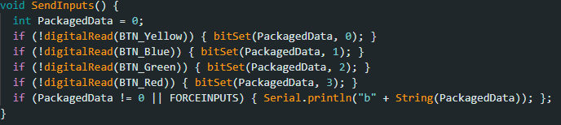
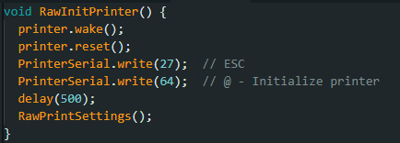
The Code - Arduino

Slide 9

The Challenges
Data Communication
Printer Code
Joysticks & XInput

Slide 10

Live Demo!
Be warned this is very much still work in progress and technical faults are bound to happen whilst working with experimental technology!

Slide 11

Progress Check
Change to Project
Game Progress
Arduino Progress
Further Aims

Slide 12

Further Production
Game Progress
Arduino Progress
Research Progress
Marketing

Slide 13

Questions?

